Slide 1
TEAM 9 - DJJM
CNT-5805 Final Project Presentation
On
Social Collaboration of Network Scientists
Given on: 11/30/2022
Dylan D’ Andrea
Jainam Shah
Jalique Francis
Matthew Olajide

Slide 2
Abstract
This research project provides a broader perspective of social collaboration between network scientists, in their field. Insights can be shared on how they collaborate with other network scientists, as well to research on topics related to network science, its integrations, formations, and varied areas within the field. We have explored based on network scientists interactions, which countries do they belong to, their gender, their knowledge based on how much they have contributed to the network field, communities formed by specific scientists, number of scientists contributing maximum in this field etc. The primary purpose to analyze the social collaboration dataset is to educate the reader about the structure of a social network and get insights on how the group of scientists collaborate with each other, perform different experiments and provide research in areas related to network science.

Slide 3
Research Questions
Are there preferred scientists as well as less preferred collaborative partners ?
Are there any distinct social circles or communities that exist within the network? For instance, Are there any communities that are closely grouped and have maximum output for the field of network science?
Are there any social hierarchies within the scientists' collaboration? Are there any Systems of social organization in which some individuals enjoy a higher social status than others? Can we find if there’s a repeating theme with one individual within some groups, then is that person higher on a social hierarchy?
Which country of origin produces the highest amount of scientists into the field of network science?
Which is the predominant gender of the scientists that contribute the most to this field?
What are the hubs of scientists who have contributed the most in the field of network science?
Are there any scientists who exclude themselves from collaboration in the field of network?
Who are the most influential scientists in the network?
Do scientists from similar backgrounds co-author more papers together?

Slide 4
Network Information
The graph of the network contains 1589 nodes and 2743 edges and it is an undirected network. The network possesses weighted edges.
Each node in the network represents a unique scientist who has authored a research paper and participates in the field of network science. The edges represent the concatenated names of scientists who contributed together or co-authored the same research paper.
The nodes also contain the data for every scientist’s Name, Gender, and Country of origin.
Data Source - https://en.wikipedia.org/wiki/List_of_network_scientists

Slide 5
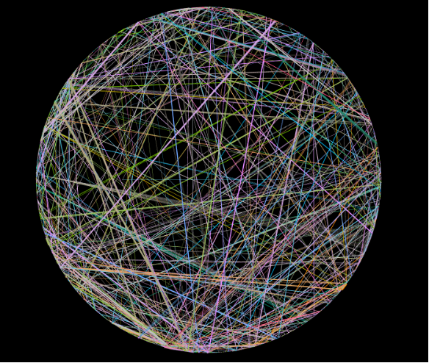
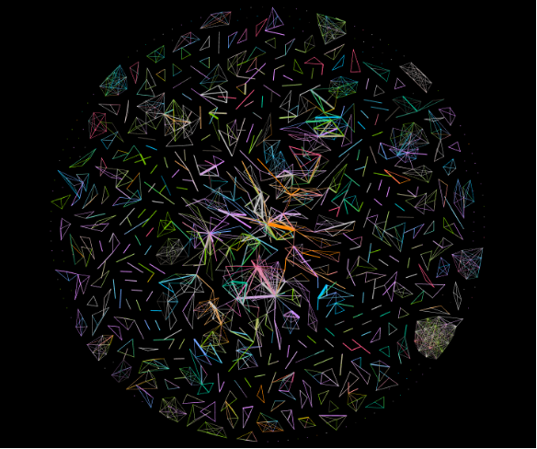
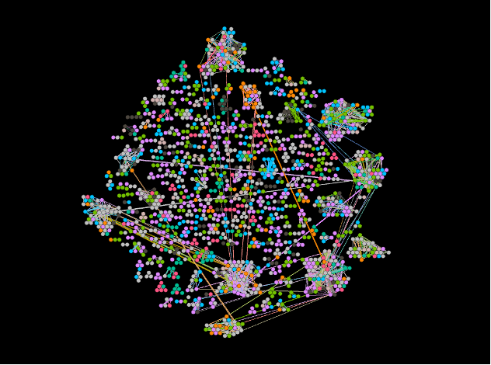
LAYOUT ALGORITHMS
Dual Circle Layout
Fruchterman Reingold Layout
Circle Pack Layout

Slide 6
Statistical Analysis
Network Density = 0.002
Average Degree = 3.451
Average Clustering Coefficient = 0.878
Betweenness Centrality:
  Diameter = 17
  Average Path Length = 5.823
Closeness Centrality - 0.1717
Modularity = 0.954
Number of Communities = 408
Connected Components = 396

Slide 7
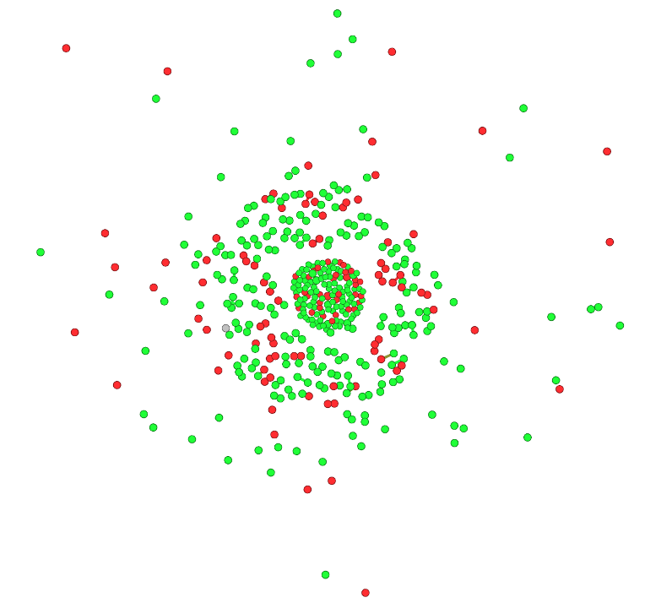
Overall Research Results
1. Are there preferred scientists as well as outlier fewer collaborative scientists?
There are 431 scientists who collaborate very rarely and if they do, it is maximum with 1 scientist. The above network is partitioned based on gender, males (green) females (red).

Slide 8
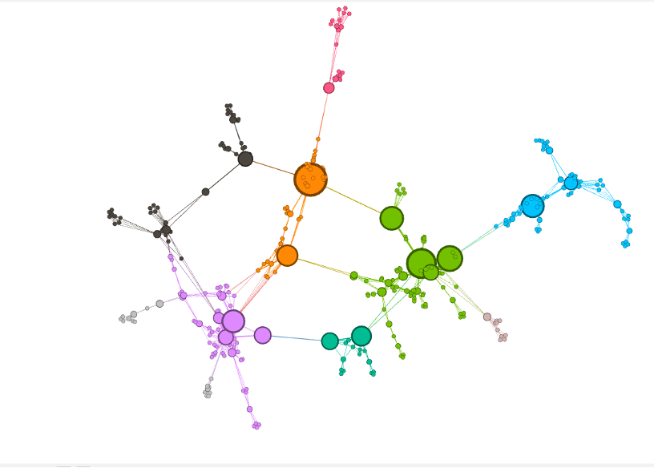
2. Are there any distinct social circles or communities that exist within the network?
Orange Community | Newman, M
Green Community | Pastorsatorras, R
Blue Community | Bocalleti, S
Dark Green Community | Caldarelli, G
Purple Community | Jeong H

Slide 9
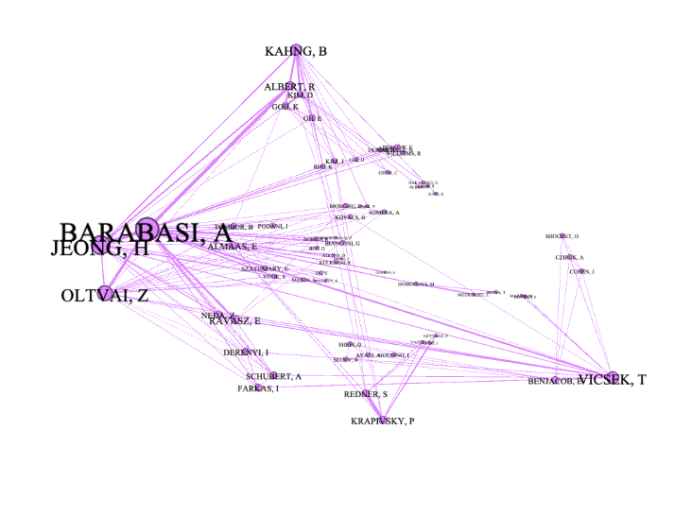
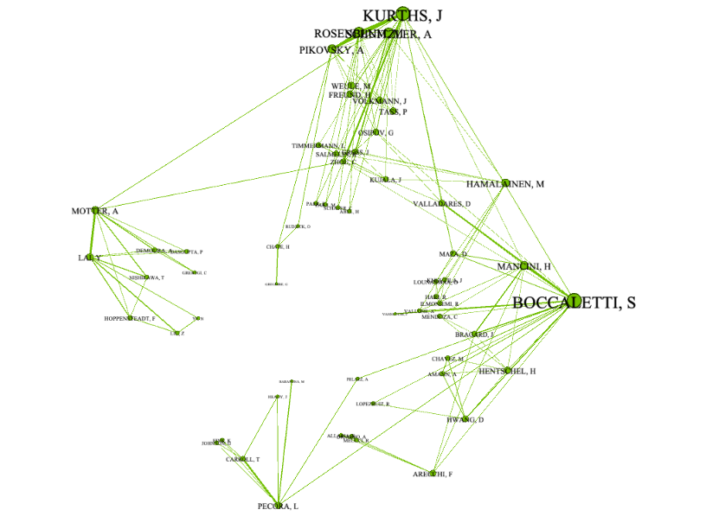
3. Are there any social hierarchies within the scientists' collaboration? Are there any Systems of social organization in which some individuals enjoy a higher social status than others? Can we find if there’s a repeating theme with one individual within some groups, then is that person higher on a social hierarchy?

Slide 10
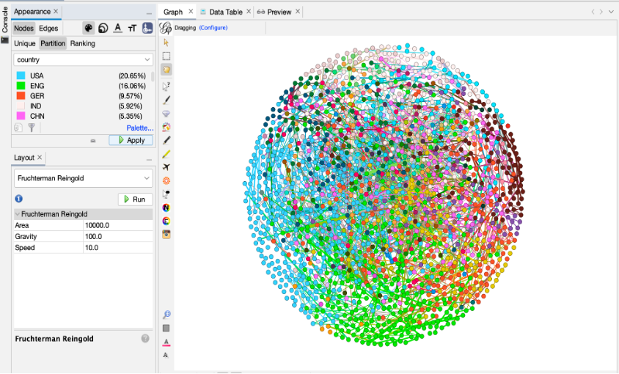
4. Which country of origin produces the highest amount of scientists into the field of network science?
The top 5 countries who contributed the most in the field of network science were The United States of America (USA), England, Germany, India and China

Slide 11
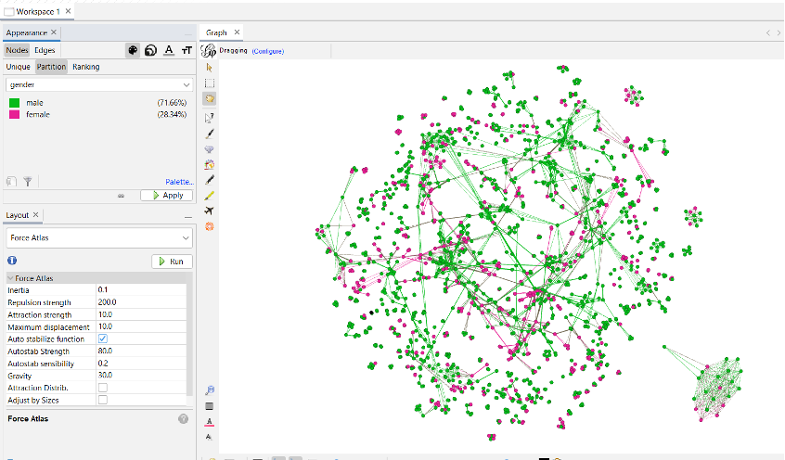
5. Which is the predominant gender of the scientists that contribute the most to this field?
In the network, male gender(green) contributes more to the network compared to females(pink). Out of the 1589 network scientists, 71.66% of the scientists are male and 28.34% of the scientists are female.

Slide 12
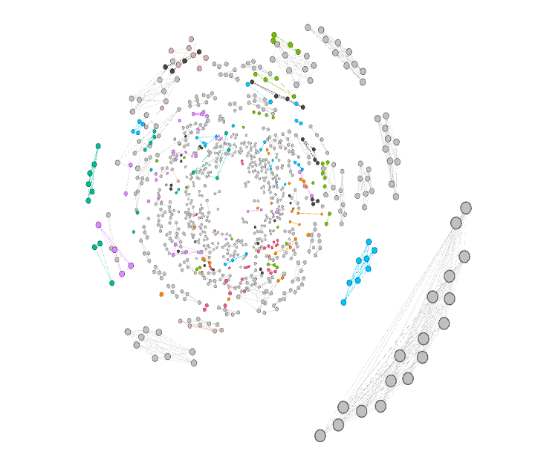
6. What are the hubs of scientists who have contributed the most in the field of network science?
The network shows scientists having connections enclosed within their specific community and not having any distant connections with other scientists creating hubs.

Slide 13
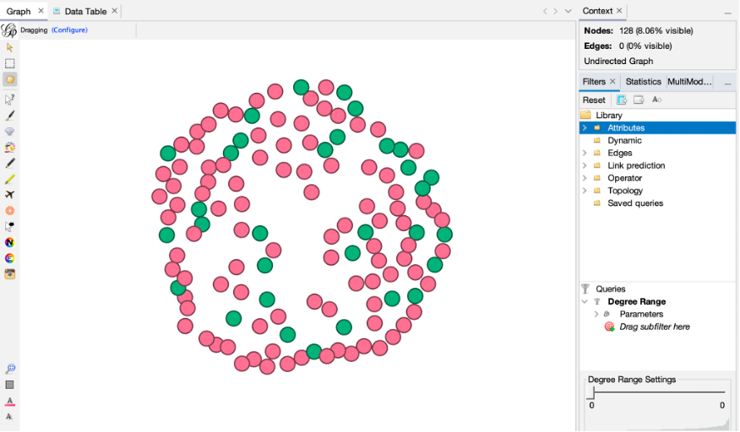
7. Are there any scientists who exclude themselves from collaboration in the field of network?
There are 128 scientists who don’t collaborate with any other network scientists. There are 30 female scientists and 98 male scientists belonging to various countries who provide their contribution individually in this field. Approximately 8% of the scientists provide contribution individually without collaborating with any of the respective scientists in the network field.

Slide 14
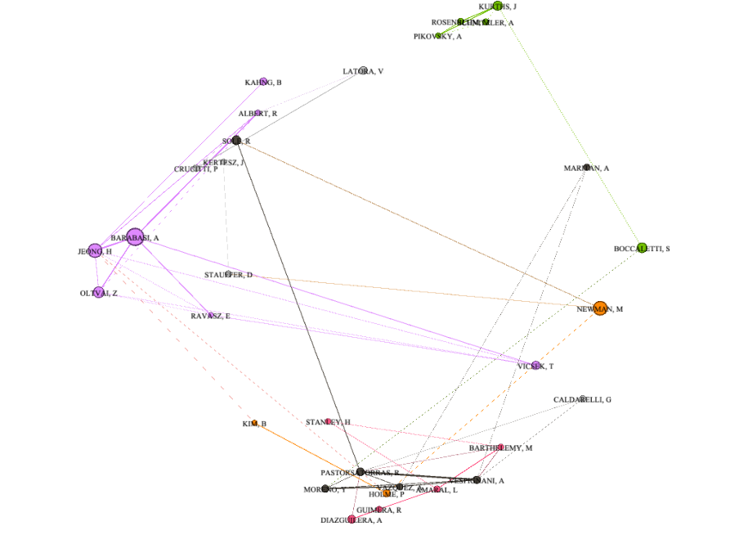
8. Who are the most influential scientists in the network?
There are 31 scientists in the network who are the most influential. They are most influential based on the fact that they have contributed to more than 10 research papers or experiments in the field of network science by collaborating with other scientists.

Slide 15
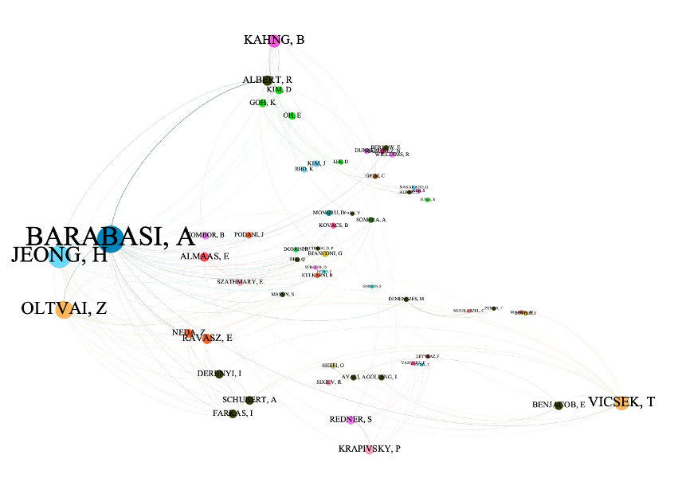
9. Do scientists from similar backgrounds co-author more papers together?
The above network shows the community (containing 64 scientists) with maximum contributions in the field of network science. It showcases many scientists from different backgrounds co-authoring many research papers or taking part in experimental studies related to network science. The backgrounds are based on the fact that the scientists belong to different countries.

Slide 16
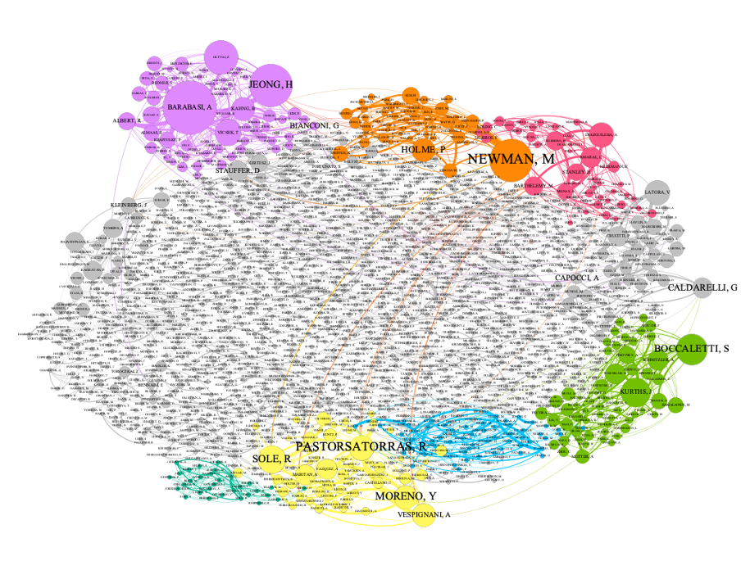
Final Network

Slide 17
Final Contemplation
The study could have been made more interesting by including following categories:-
Ages of the scientists : This metric could be used to gain further insight on how this factor played into collaboration between network scientists, to ascertain whether or not preferences based on age exist.
Educational institutions the scientists or professors belong to - a good amount of hubs and communities in the network can be created if educational institutions are revealed and help discern the world renowned institutes who provide their contribution in network science.
In terms of dividing the workload between our group members, we were all very agreeable as to how we divided the workload, and we all supported each other in our shared contribution. We did not have any problems or gripes within the group during our contributions to the final project.
This project was combined effort amongst all team members. There were no difficulties in dividing the work. The data did not require much cleansing or preparation and we answered all of our research question and managed to think of a few more in the process.Overall a good analysis of social network.

Slide 18
Thank you!😊

